Slide 1
Unit 2 - Lecture 16
IDA* algorithm (Iterative Deepening A*)

Slide 2
IDA* algorithm
Algorithm IDA* is basically an extension of DFID algorithm seen earlier.
IDA* is to A* what DFID was to DFS.
It converts the algorithm to a linear space algorithm, though at the expense of an increased time complexity.
It capitalizes on the fact that the space requirements of Depth First Search are linear.
Further, it is amenable to parallel implementations, which would reduce execution time further.
A simple way to do that would be to assign the different successors to different machines, each extending different partial solutions.

Slide 3
The IDA* algorithm is described below in next figure .
The algorithm uses a search bound captured in a variable named cutoff.
The initial value of cutoff is set to the lower bound cost, as seen from the start node S.
Since this is a lower bound, any solution found within cutoff cost must be optimal.
The observant reader would have noticed that it is quite unlikely that the solution would be found in the first iteration when cutoff = f(S).
This is because the heuristic function is designed to underestimate the optimal cost.

Slide 4
However, if the DFS search fails, in the next iteration the cutoff value is incremented to the next lowest f-value from the list OPEN.
In this way, the value of cutoff is increased incrementally to ensure that in any iteration, only an optimal cost solution can be found.

Slide 5
While the algorithm IDA* essentially does Depth First Search in each iteration, the space that it explores is biased towards the goal.
This is because the f-value used for each node is the sum of the g-value and the h-value.
As for paths that are leading away from the goal, the h-values will increase and such paths would be cut off early.
Thus, while DFS itself is without a sense of direction, the fact that f-values are used to prune the search pulls the overall envelope that it searches within towards the goal node as depicted in next figure .
Like DFS, the space required of IDA* grows linearly with depth.
We do not need to maintain a CLOSED list if we keep track of the solution path explicitly.

Slide 6
There is, however, a drawback that in problems like city map route, finding the algorithm may expand internal nodes many times.
This happens because there are many routes to a node, and each time the node is expanded all over again.
For large problem sizes, this can become a problem.
Next figure illustrates the search space explored by IDA* with some value of cutoff.
One can see that there are combinatorially many paths to any node within the cutoff range.
In the absence of a CLOSED list, IDA* will visit all nodes through all possible paths.
Nevertheless, for many problems, IDA* can be a good option, especially if the number of combinations are small.

Slide 8
A factor that may adversely affect running time is when the increment in the cutoff value is such that only a few more nodes are included in each cycle.
In the worst case, only one node may be added in each iteration.
While this is necessary to guarantee admissibility, one could trade off execution time with some controlled loss in the solution cost.
For example, one could decide in advance that the cutoff bounds will be increased by a value § that is predetermined.
The loss then will be bounded by § , and an appropriate choice may be made for a given application.
Next figure illustrates this situation. In the illustration, two goal nodes come within the ambit of cutoff when it is increased by §.

Slide 9
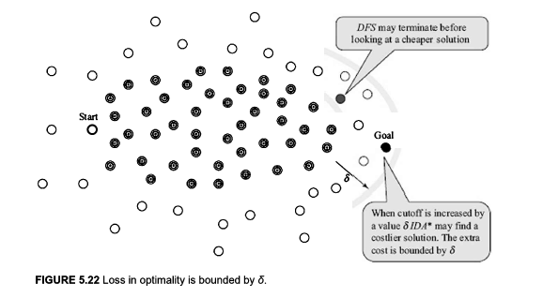
However, since the underlying search is DFS, it may terminate with the more expensive solution.

